Slide 1
ELEMENTARY STATISTICS, BLUMAN
Misuses of Data
© 2019 McGraw-Hill Education. All rights reserved. Authorized only for instructor use in the classroom. No reproduction or further distribution permitted without the prior written consent of McGraw-Hill Education.

Slide 2
Objectives for this PowerPoint
Identify and avoid the following ways that data is misused to create a false impression:
Suspect Samples
Ambiguous Averages
Changing the Subject
Detached Statistics
Implied Connections
Misleading Graphs

Slide 3
Data
Data is used appropriately every day to attempt to describe populations, compare populations, determine relationships between variables, test hypotheses, and make estimates about population characteristics.
However, data is also frequently misused to sell products that don’t work properly, to attempt to prove something true that is not really true, or to get our attention by using statistics to evoke fear, shock, and outrage.

Slide 4
Suspect Samples (1)
It is important that sample sizes are large enough, and that the subjects in the sample were selected randomly.
Consider the statement “3 out of 4 doctors recommend pain reliever A”. If the sample contained only 4 doctors, then the data set is certainly not large enough to draw a significant conclusion. A sample size of 100 doctors might suggest more reliable results.
A sample size of 100 doctors might suggest more reliable results. However, if the 100 doctors in the survey were selected conveniently at a conference sponsored by Pain Reliever A, then the results might suggest some bias that would render the results unreliable.

Slide 5
Suspect Samples (2)
It is important that sample sizes are large enough, and that the subjects in the sample were selected randomly.
If new media outlets relied on samples taken at elementary schools for election polling, your favorite super hero could very well be mistakenly reported as the front runner for the presidential election.

Slide 6
Ambiguous Averages (1)
There are four commonly used measures that are loosely called averages
Mean
Median
Mode
Midrange

Slide 7
Ambiguous Averages (2)
A reporter of statistics, in an attempt to convince his reader to see his point of view, may use the mean to describe a data set that contains a few extreme data values when the median might be a much better descriptor of the central tendencies of the population.

Slide 8
Ambiguous Averages (3)
Consider the following closing prices for all 10 homes sold in a given month in a small town.
A quick examination of the data, shows that homes in this area frequently sell in the mid $100,000 of dollars.
However, we can see that there are more expensive properties that sell in this market as well.
Closing Price
$135k | $147k | $158k | $167k | $450k
$142k | $153k | $159k | $168k | $675k
Mean = $235,400
Median = $158,500

Slide 9
Ambiguous Averages (4)
If the individual data values were unavailable and someone attempted to characterize the data set by reporting only the mean of $235,400.
It would create a false impression with regard to the actual housing market in this town.
The median closing price is $158,500, which is much more representative of the actual housing market in this town.
As you progress through the study of statistics you’ll find that the median is frequently the better measure to characterize data sets that contain extreme data values.

Slide 10
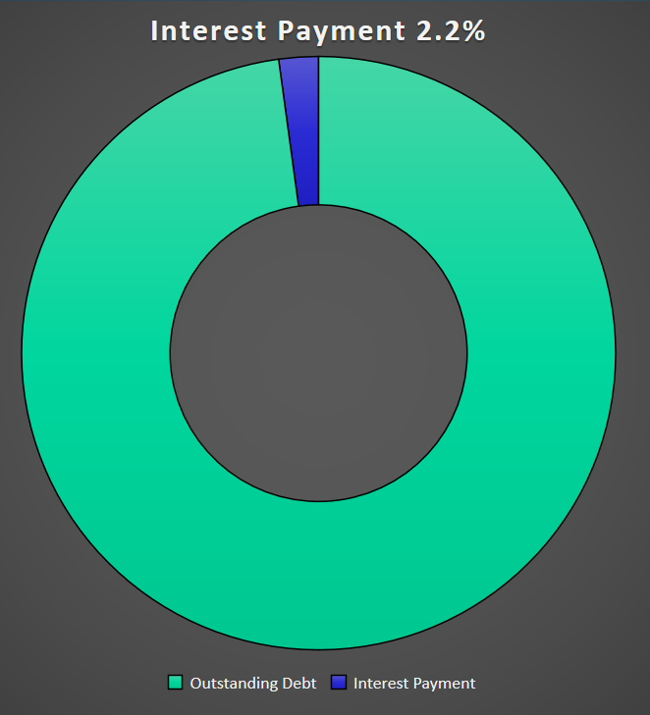
Changing the Subject (1)
Statistical distortion can occur when different values are used to represent the same data.

Slide 11
Changing the Subject (2)
One politician trying to make his point might make the following statement:
The interest payment on outstanding debt for the US Government in 2015 was about 2.2% of the outstanding debt.

Slide 12
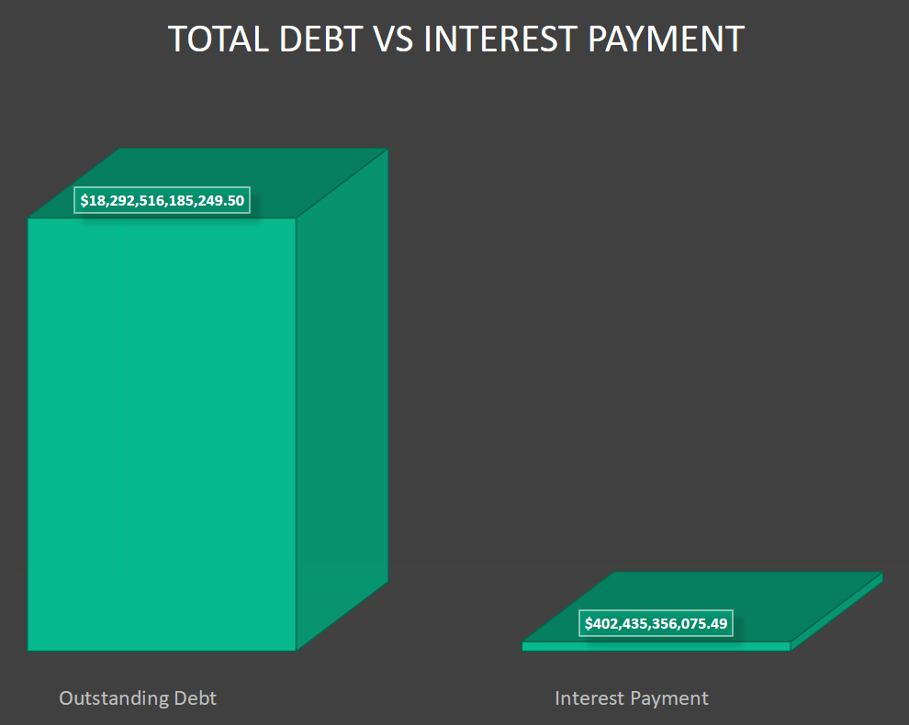
Changing the Subject (3)
Statistical distortion can occur when different values are used to represent the same data.

Slide 13
Changing the Subject (4)
Another politician might attempt to make his point with the following statement:
The interest payment on outstanding debt for the US Government in 2015 was about $402,435,3556,075.49
While both figures represent the same debt payment, using a value like 2.2% to represent such a large number is certainly misleading.

Slide 14
Detached Statistics
A claim that uses a detached statistic is one in which no comparison is made.
Consider the statement:
People who use this diet lose an average of 10 more pounds per day.
No comparison is provided so the question that should be asked is: 10 more pounds per day than what?

Slide 15
Implied Connections
A claim might attempt to imply connections between 2 variables where no connection actually exists.
The advertising claim “Eating one bowl of our oatmeal cereal every morning may improve your child’s ability to focus at school” does not specifically guarantee an increase in academic performance. But the benefit is certainly implied.

Slide 16
Misleading Graphs (1)
Graphs that are inappropriately drawn can lead a reader to draw false conclusions.
Compare the two graphs on the next slide that are intended to represent the results from the same preference survey.

Slide 17
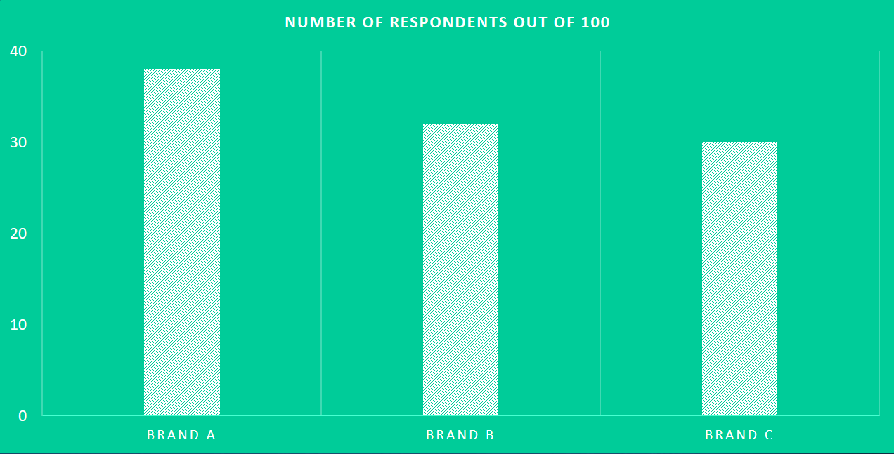
Misleading Graphs (2)

Slide 18
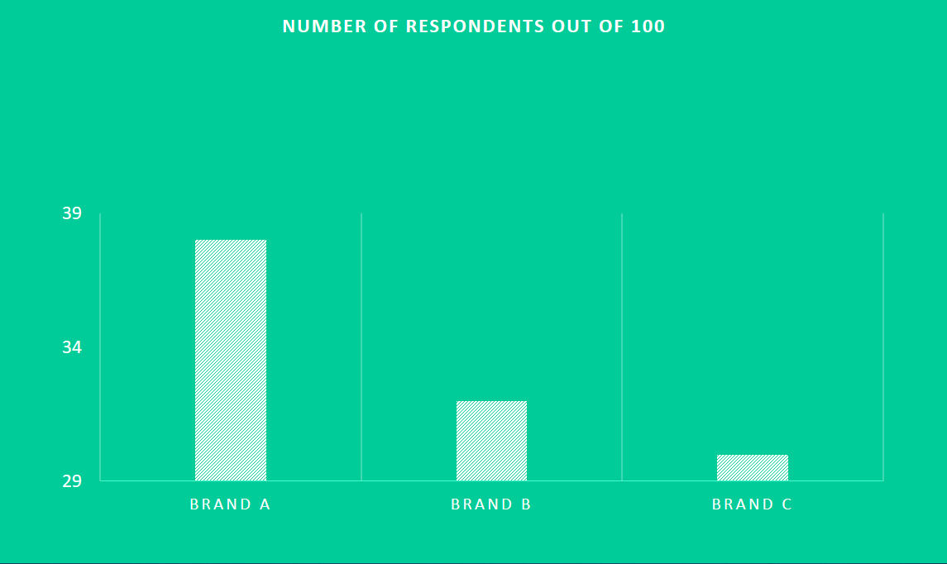
Misleading Graphs (3)

Slide 19
Misleading Graphs (4)
Note that the graph on the right, the y-axis starts at 29 rather than 0 as with the graph on the left.
Note that the graph on the right implies that the preference for brand A is many times the preference for brands B and C.
By starting the y-axis at 0, the graph on the left demonstrates the true proportional relationship between the categories in the data set.

Slide 20
Summary
Identify and avoid the following ways that data is misused
Suspect Samples
Ambiguous Averages
Changing the Subject
Detached Statistics
Implied Connections
Misleading Graphs

